Slide 1
Embedded Systems
Casino Gambling Machine

Slide 2
Casino Gambling Machine
Implement one of two games with the Rich Shield
Roulette using digit segments
Wheel of Fortune using scrolling numbers
The application uses the display, two buttons and the buzzer. You can dress the application with LED and melodies.

Slide 3

Roulette
Wheel rotation

Slide 4
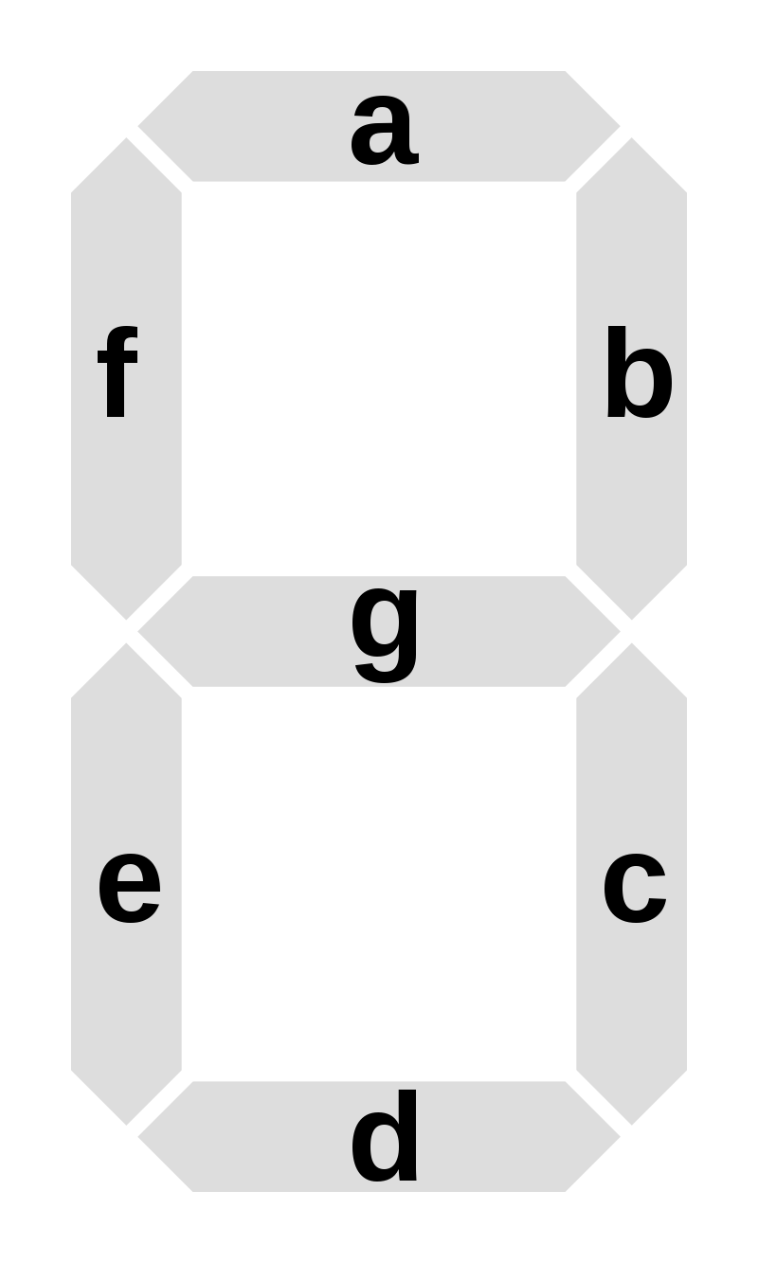










Roulette
#include “Display.h”
Constants:
SEG_a,
SEG_b,
SEG_c,
SEG_d,
SEG_e,
SEG_f,
SEG_g,
SEG_DOT
Display.showDigitAt(pos, digit);
pos = { 0, 1, 2, 3 }
digit = segment pattern
Display.showDigitAt(pos, SEG_CLR);
Display.showDigitAt(pos, SEG_a | SEG_b);
Display.showCharAt(pos, ‘7’);
SEG_CLR
SEG_a
SEG_b
SEG_c
SEG_d
SEG_e
SEG_f
SEG_g
SEG_DOT

Slide 5
Roulette – Example (1/2)
Does not block
#include “Display.h”
enum RouletteStates {
ROULETTE1, ROULETTE2, ROULETTE3,
ROULETTE4, ROULETTE5, ROULETTE6
};
enum RouletteStates state = ROULETTE1;
void setup() {
Display.clear();
}
void loop() {
WheelStep();
delay(100);
}
void WheelStep() {
byte seg;
switch (state) {
case ROULETTE1:
seg = SEG_a;
state = ROULETTE2;
break;
case ROULETTE2:
seg = SEG_b;
state = ROULETTE3;
break;
case ROULETTE3:
seg = SEG_c;
state = ROULETTE4;
break;
case ROULETTE4:
seg = SEG_d;
state = ROULETTE5;
break;
case ROULETTE5:
seg = SEG_e;
state = ROULETTE6;
break;
case ROULETTE6:
seg = SEG_f;
state = ROULETTE1;
break;
}
Display.showDigitAt(0, seg);
}
Animation step
This is for one digit, you can extend this to use all 4 digits
Other tasks

Slide 6
Roulette – Example (2/2)
#include “Display.h”
byte rouletteStates[] = { ... };
byte wheelIndex, pos, seg;
void setup() {
Display.clear();
}
void loop() {
wheelStep();
delay(100);
}
void wheelStep() {
pos = rouletteStates[wheelIndex];
seg = rouletteStates[wheelIndex+1];
wheelIndex = (wheelIndex + 2) % 24;
...
Display.showDigitAt(pos, seg);
}
The last pos and seg on display define the target segment.

Slide 7
Wheel of Fortune
Wheel rotation
0 1 2 3 4 5 6 7 8 9 0 1 2 3 4 5 6 7 8 9 0 1 2 3 4 5 6 7 8 9 0 1 2 3 4 5 6 7 8 9 0 1 2 3 4 5 6 7 8 9 0 1 2 3 4 5
We can’t make an infinite array of numbers, or can we?
We don’t have the amount memory
But we can make a cyclic array!
The value at pos 1 on display defines the target number

Slide 8
Wheel of Fortune – Example
#include “Display.h”
byte wheelOfFortuneStates[] = { ... };
byte displayElements[5] = { 0 };
byte wheelIndex, pos, seg;
void setup() {
Display.clear();
}
void loop() {
wheelStep();
delay(100);
}
void wheelStep() {
byte elementIndex = wheelIndex;
for (byte i = 0; i < 4; i++) {
displayElements[i] = wheelOfFortuneStates[elementIndex];
elementIndex = (elementIndex + 1) % 10;
}
wheelIndex = (wheelIndex + 1) % 10; // cyclic index.
...
Display.show(displayElement);
}
Cyclic indexing creates a cyclic array

Slide 9
Debouncing buttons – temporarily blocking
int lastButton1State = HIGH;
void loop() {
int value;
value = readDebouncedButton1();
if (value) {
// do something when button is pressed.
}
}
int readDebouncedButton1() {
int buttonState = digitalRead(BUTTON1);
if (buttonState != lastButton1State) {
lastButton1State = buttonState;
if (buttonState == LOW) {
delay(20);
buttonState = digitalRead(BUTTON1);
if (buttonState == LOW) {
return true; // button is pressed.
}
} }
return false; // button is not pressed.
}
Blocks everything for a short amount of time

Slide 10
Debouncing buttons – blocking free
enum ButtonState {
PRESSED,
RELEASED,
UNKNOWN
};
int lastButton1State = HIGH;
long lastButton1Time = 0;
void loop() {
int value;
value = readDebouncedButton1();
if (value == PRESSED) {
// do something when button is pressed.
}
}
enum ButtonState readDebouncedButton1() {
int buttonState = digitalRead(BUTTON1PIN);
if (buttonState != lastButton1State) {
lastButton1State = buttonState;
if ((millis() - lastButton1Time) > 20) {
lastButton1Time = millis();
if (buttonState == LOW) {
return PRESSED;
} else {
return RELEASED;
}
}
}
return UNKNOWN;
}
Notes:
Students should use this for the assignment to read the buttons.

Slide 11
Blink display – blocking free
enum BlinkState {
ON, OFF, DELAYON, DELAYOFF
};
enum BlinkState blink_state = ON;
long animateTime = 0;
void loop() {
// Blink 5 times.
for (int i = 0; i < 5; i++) {
bool result = false;
while (!result) {
result = blinkDisplayStep(1000);
}
}
}
bool blinkDisplayStep(int period) {
switch(blink_state) {
case ON:
Display.on();
blink_state = DELAYON;
animateTime = millis();
break;
case DELAYON:
if ((millis()–animateTime) > period/2)
{
blink_state = OFF;
}
break;
case OFF:
Display.off();
blink_state = DELAYOFF;
animateTime = millis();
break;
Blocking until 5 times
Blocking until completed
case DELAYOFF:
if ((millis()–animateTime) > period/2)
{
blink_state = ON;
return true;
}
break;
}
return false;
}
Non-blocking

Slide 12
Blink display – blocking free
enum BlinkState {
ON, OFF, DELAYON, DELAYOFF
};
enum BlinkState blink_state = ON;
long animateTime = 0;
void loop() {
// Blink 5 times.
for (int i = 0; i < 5; i++) {
bool result = false;
while (!result) {
result = blinkDisplayStep(1000);
}
}
// Simultaneous actions
}
How can we make this structure blocking free?
Giving simultaneous actions more execution time.
Slowed down by blinking

